Slide 1

INFO-6079 Week 9
CLASS – Inheritance, Polymorphism

Slide 2
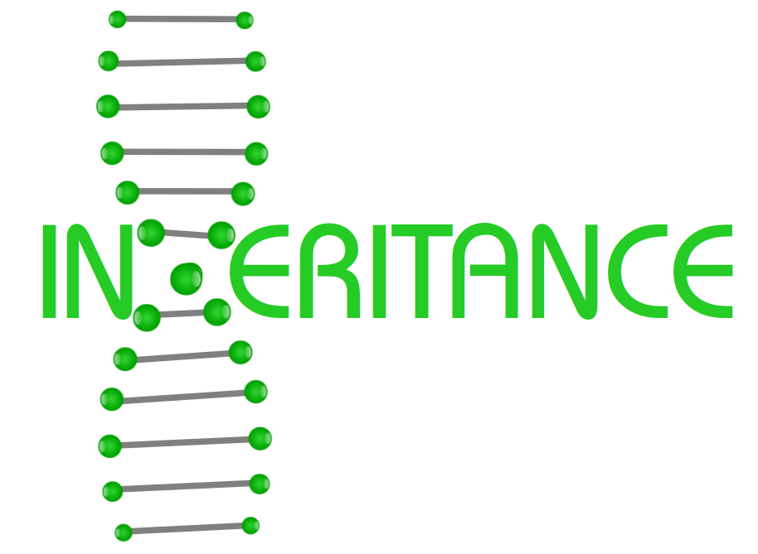
Introduction & Definitions Inheritance
Every object-oriented programming language would not be worthy to look at or use, if it weren't to support inheritance.
Inheritance was invented in 1969 for Simula.
Python not only supports inheritance but multiple inheritance as well.
Generally speaking, inheritance is the mechanism of deriving new classes from existing ones. By doing this we get a hierarchy of classes.
In most class-based object-oriented languages, an object created through inheritance (a "child object") acquires all of the properties and behaviors of the parent object.

Slide 3
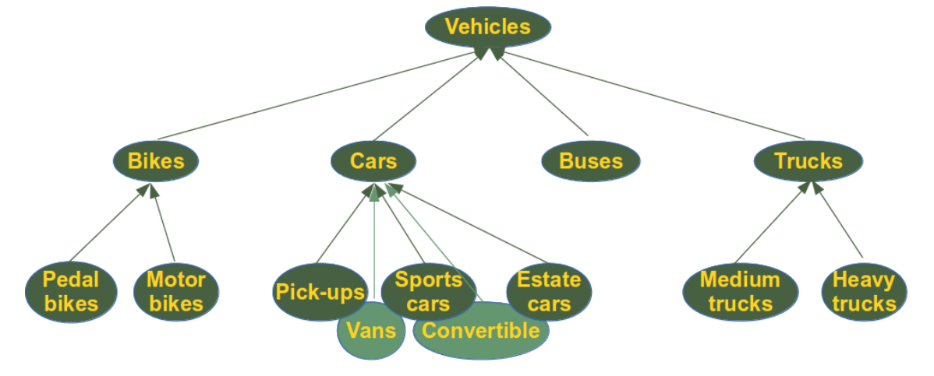
Introduction & Definitions Inheritance

Slide 4
Syntax of Inheritance
The syntax for a subclass definition looks like this:
class DerivedClassName(BaseClassName):
pass
Instead of the pass statement, there will be methods and attributes like in all other classes.
The name BaseClassName must be defined in a scope containing the derived class definition.

Slide 5
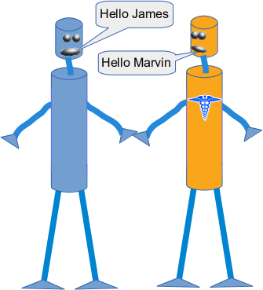
Example Inheritance
class Robot:
def __init__(self, name):
self.name = name
def say_hi(self):
print("Hi, I am " + self.name)
class PhysicianRobot(Robot):
pass
x = Robot("Marvin")
y = PhysicianRobot("James")
print(x, type(x))
print(y, type(y))
y.say_hi()
Notes:
If you look at the code of our PhysicianRobot class,
you can see that we haven't defined any attributes or methods in this class.
As the class PhysicianRobot is a subclass of Robot, it inherits in this case both the method __init__ and say_hi.
Inheriting these methods means that we can use them as if they had been defined in the PhysicianRobot class.
When we create an instance of PhysicianRobot, the __init__ function will also create a name attribute.
We can apply the say_hi method to the PhysisicianRobot object y, as we can see in the output from the code above.

Slide 6
Type and isinstance
x = Robot("Marvin")
y = PhysicianRobot("James")
print(isinstance(x, Robot), isinstance(y, Robot))
print(isinstance(x, PhysicianRobot))
print(isinstance(y, PhysicianRobot))
print(type(y) == Robot, type(y) == PhysicianRobot)
Output:
True True
False
True
False True
Notes:
You should also pay attention to the following facts,
where the difference between checking the type via the type function or the function isinstance is located.
The difference can be seen in the code.
We see that isinstance returns True if we compare an object either with the class it belongs to or with the superclass.
Whereas the equality operator only returns True, if we compare an object with its own class.

Slide 7
isinstance
This is even true for arbitrary ancestors of the class in the inheritance line:
class A:
pass
class B(A):
pass
class C(B):
pass
x = C()
print(isinstance(x, A))
True

Slide 8
Overriding
class Robot:
def __init__(self, name):
self.name = name
def say_hi(self):
print("Hi, I am " + self.name)
class PhysicianRobot(Robot):
def say_hi(self):
print("Everything will be okay! ")
print(self.name + " takes care of you!")
y = PhysicianRobot("James")
y.say_hi()
Everything will be okay!
James takes care of you!
Notes:
get back to our new PhysicianRobot class.
Imagine now that an instance of a PhysicianRobot should say hi in a different way.
In this case,
we have to redefine the method say_hi inside of the subclass PhysicianRobot:

Slide 9
Overriding
y = PhysicianRobot("Doc James")
y.say_hi()
print("... and now the 'traditional' robot way of saying hi :-)")
Robot.say_hi(y)
Everything will be okay!
Doc James takes care of you!
... and now the 'traditional' robot way of saying hi :-)
Hi, I am Doc James
Notes:
What we have done in the previous example is called overriding.
A method of a parent class gets overridden by simply defining in the child class a method with the same name.
If a method is overridden in a class, the original method can still be accessed, but we have to do it by calling the method directly with the class name, i.e. Robot.say_hi(y).

Slide 10
Inheritance Example
We have seen that an inherited class can inherit and override methods from the superclass.
Besides this a subclass often needs additional methods with additional functionalities, which do not exist in the superclass.
An instance of the PhysicianRobot class will need for example the method heal so that the physician can do a proper job.
We will also add an attribute health_level to the Robot class, which can take a value between 0 and 1. .
Notes:
Show example
W09_inheritance001.py

Slide 11
Inheritance Example
The robots will 'come to live' with a random value between 0 and 1. If the health_level of a Robot is below 0.8, it will need a doctor.
We write a method needs_a_doctor which returns True if the value is below 0.8 and False otherwise.
The 'healing' in the heal method is done by setting the health_level to a random value between the old health_level and 1.
This value is calculated by the uniform function of the random module.
Notes:
Show example
W09_inheritance001.py

Slide 12
Inheritance Example
class PhysicianRobot(Robot):
def say_hi(self):
Robot.say_hi(self)
print("and I am a physician!")
doc = PhysicianRobot("Dr. Frankenstein")
doc.say_hi()
Hi, I am Dr. Frankenstein
and I am a physician!
Notes:
Show example
W09_inheritance001.py
When we override a method, we sometimes want to reuse the method of the parent class and at some new stuff.
To demonstrate this, we will write a new version of the PhysicianRobot. say_hi should return the text from the Robot class version plus the text " and I am a physician!"

Slide 13
Inheritance Example
class PhysicianRobot(Robot):
def say_hi(self):
super().say_hi()
print("and I am a physician!")
doc = PhysicianRobot("Dr. Frankenstein")
doc.say_hi()
Hi, I am Dr. Frankenstein
and I am a physician!
Notes:
We don't want to write redundant code and therefore we called Robot.say_hi(self). We could also use the super function.
super is not always necessary in this case.
One could argue that it makes the code more maintainable, because we could change the name of the parent class, but this is seldom done anyway in existing classes.
The real benefit of super shows when we use it with multiple inheritance.

Slide 14
Overwriting, Overloading and Overriding
def f(x):
return x + 42
print(f(3))
# f will be overwritten (or redefined) in the following:
def f(x):
return x + 43
print(f(3))
45
46
Notes:
If we overwrite a function, the original function will be gone.
The function will be redefined.
This process has nothing to do with object orientation or inheritance.

Slide 15
Overwriting, Overloading and Overriding
In the context of object-oriented programming, you might have heard about "overloading" as well.
Even though "overloading" is not directly connected to OOP. Overloading is the ability to define a function with the same name multiple times.
The definitions are different concerning the number of parameters and types of the parameters.
It's the ability of one function to perform different tasks, depending on the number of parameters or the types of the parameters.
We cannot overload functions like this in Python, but it is not necessary neither.
Notes:
If we overwrite a function, the original function will be gone.
The function will be redefined.
This process has nothing to do with object orientation or inheritance.

Slide 16
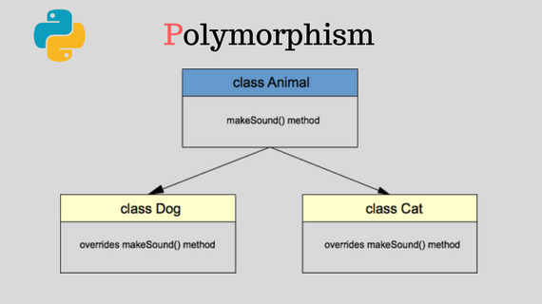

Slide 17
Polymorphism
Sometimes an object comes in many types or forms.
If we have a button, there are many different draw outputs (round button, check button, square button, button with image) but they do share the same logic: onClick(). We access them using the same method .
This idea is called Polymorphism.
Polymorphism is based on the greek words Poly (many) and morphism (forms). We will create a structure that can take or use many forms of objects.

Slide 18
Polymorphism
class Bear(object):
def sound(self):
print("Groarrr")
class Dog(object):
def sound(self):
print("Woof woof!")
def makeSound(animalType):
animalType.sound()
bearObj = Bear()
dogObj = Dog()
makeSound(bearObj)
makeSound(dogObj)
Notes:
Polymorphism with a function:
We create two classes:
Bear and Dog, both can make a distinct sound.
We then make two instances and call their action using the same method.

Slide 19
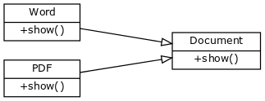
Polymorphism
Polymorphism with abstract class (most commonly used)
If you create an editor you may not know in advance what type of documents a user will open (pdf format or word format?).
Notes:
Polymorphism with a function:
We create two classes:
Bear and Dog, both can make a distinct sound.
We then make two instances and call their action using the same method.

Slide 20
Polymorphism
Wouldn’t it be great to access them like this, instead of having 20 types for every document?
for document in documents:
print document.name + ': ' + document.show()
Notes:
Polymorphism with a function:
We create two classes:
Bear and Dog, both can make a distinct sound.
We then make two instances and call their action using the same method.

Slide 21
Polymorphism
Wouldn’t it be great to access them like this, instead of having 20 types for every document?
for document in documents:
print document.name + ': ' + document.show()
Notes:
Polymorphism with a function:
We create two classes:
Bear and Dog, both can make a distinct sound.
We then make two instances and call their action using the same method.

Slide 22
Polymorphism
class Document:
def __init__(self, name):
self.name = name
def show(self):
raise NotImplementedError("Subclass must implement abstract method")
class Pdf(Document):
def show(self):
return 'Show pdf contents!'
class Word(Document):
def show(self):
return 'Show word contents!'
documents = [Pdf('Document1'),
Pdf('Document2'),
Word('Document3')]
for document in documents:
print document.name + ': ' + document.show()
Notes:
To do so, we create an abstract class called document.
This class does not have any implementation but defines the structure (in form of functions) that all forms must have.
If we define the function show() then both the PdfDocument and WordDocument must have the show() function.

Slide 23
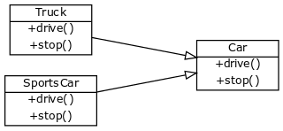
Polymorphism example
Structure in abstract class, implementation in other classes
Another example would be to have an abstract class Car which holds the structure drive() and stop().

Slide 24
Polymorphism example
We define two objects Sportscar and Truck, both are a form of Car.
In pseudo code what we will do is:
class Car:
def drive abstract, no implementation.
def stop abstract, no implementation.
class Sportscar(Car):
def drive: implementation of sportscar
def stop: implementation of sportscar
class Truck(Car):
def drive: implementation of truck
def stop: implementation of truck

Slide 25
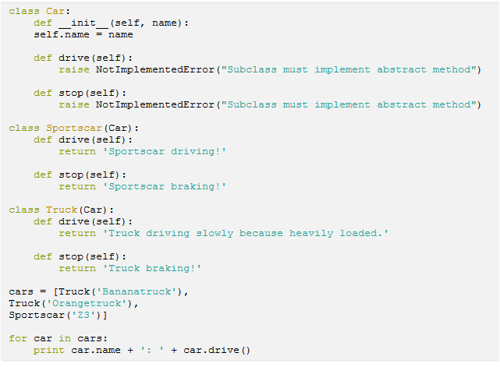
Polymorphism example
Then we can access any type of car and call the functionality without taking further into account if the form is Sportscar or Truck.

Slide 26
References
Inheritance
2011 - 2020, Bernd Klein, Bodenseo; Design by Denise Mitchinson adapted for python-course.eu by Bernd Klein
Polymorphism
https://pythonspot.com/polymorphism/

